Slide 1

RAFIK’S KITCHEN ANALYSIS REPORT - 2022

Slide 2

Observed KPI’s
Total Revenue - ₹ 9.78M
Total Expenses - ₹ 6.65M
Total Profit - ₹ 3.13M
Profit Margin – 31.97%
Average Revenue Per Day - ₹ 28.34K

Slide 3

Monthly Revenue, Expenses & Profit
MONTH | REVENUE | EXPENSES | PROFIT
JANUARY | ₹907K | ₹606K | ₹301K
FEBRAURY | ₹844K | ₹571K | ₹273K
MARCH | ₹934K | ₹622K | ₹312K
APRIL | ₹465K | ₹300K | ₹165K
MAY | ₹838K | ₹569K | ₹269K
JUNE | ₹853K | ₹584K | ₹269K
JULY | ₹825K | ₹566K | ₹259K
AUGUST | ₹871K | ₹589K | ₹282K
SEPTEMBER | ₹829K | ₹567K | ₹262K
OCTOBER | ₹808K | ₹556K | ₹252K
NOVEMBER | ₹783K | ₹554K | ₹229K
DECEMBER | ₹817K | ₹563K | ₹253K

Slide 4




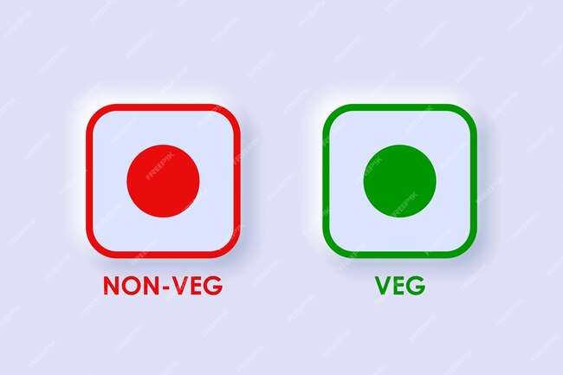
PAYMENT MODE OF SALES PERCENT
UPI – 36.34%
CARD – 32.14%
CASH – 31.52%
PERCENTAGE OF VEG & NON–VEG ORDERS
VEG – 31.06%
NON-VEG – 68.94%

Slide 5

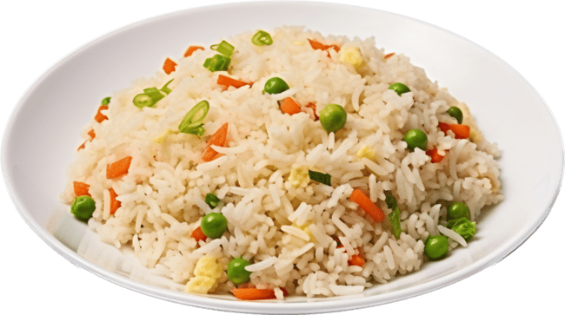




SALES BY CATEGORY
MAIN COURSE – 13.55K
SIDE DISH – 9.22K
STAETRS – 9K
SOFT DRINKS – 6.4K

Slide 6

Item-Wise Sales With Quantities
Top 5 Best Selling Items
Bottom 5 Worst Selling Items
Chicken fried Rice – 6872
Chicken Noodles – 6068
Coco Cola – 4682
Pepsi – 4480
Mojito (Blue) - 4344
Grilled Chicken Half (Garlic) -659
Grilled Chicken Quarter (Pepper) – 629
Grilled Chicken Quarter (Mint) – 478
Grilled Chicken Quarter – 439
Grilled Chicken Half (Mint) - 191

Slide 7

Item-Wise Sales Revenue
Top 5 Best Revenue Generating Items
Grilled Chicken Full – ₹ 6,88,710
Chicken Fried Rice - ₹ 6,18,480
Chicken Noodles – ₹ 5,46,300
Grilled Chicken Full (Mint) – ₹ 5,36,750
Grilled Chicken Full (Pepper) - ₹ 5,22,550

Slide 8

Item-Wise Sales Revenue
Bottom 5 Worst Revenue Generating Items
Chicken 65 – ₹ 61,600
Grilled Chicken Quarter (Mint) - ₹ 57,360
Egg Chilli Parotta – ₹ 55,350
Grilled Chicken Quater– ₹ 43,900
Grilled Chicken Half (Mint) - ₹ 38,200

Slide 9

EXPENSE BY CATEGORY
EXPENSES | AMOUNT
Daily Fresh Chicken | ₹ 16,69,619
Indian Stores | ₹ 9,97,481
Salary | ₹ 7,61,020
Ravi Essence | ₹ 6,91,068
Gas | ₹ 5,73,540
Mullai Veggies | ₹ 3,70,875
Reliance Fresh | ₹ 3,38,663
Reshman Mart | ₹ 3,21,135
Ram Plastics | ₹ 2,59,591
C.S Eggs | ₹ 2,19,343
Rent | ₹ 1,80,000
Bake Point | ₹ 1,15,581
E.B | ₹ 61,930
Hotel Asha | ₹ 50,534
Global Agro Traders | ₹ 34,500
Misc. Expenses | ₹ 7,200
Total | ₹ 66,52,080

Slide 10



INSIGHTS FROM
A2Z DATA PROFESSIONAL SERVICE
E-mail : a2z.dataprofessionals3@gmail.com
Contact : 04527961907

